Slide 1

Classification / Prediction
Notes:
In this section we’re going to learn about what I think of as the heart of machine all learning: that is, classification and prediction. And I say that, because regardless of whether you’re doing K-nearest neighbor or neural nets or support vector machines or whatever the buzz-word methodology of the moment is, in the end you’re building a model and then using it to make a prediction.

Slide 2
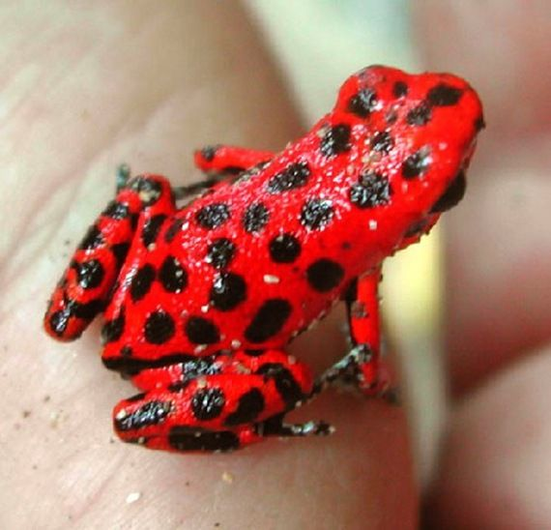
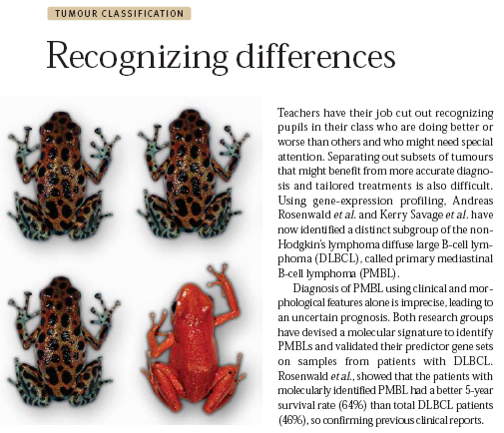
Classification
“Supervised Learning”
Use a “training set” of examples to create a model that is able to predict, given an unknown sample, which of two or more classes that sample belongs to.
?
Notes:
So let’s start with the basics: Classification is a type of supervised learning. Given a set of known data - which is called the training set - we then build a model which we’ll use to predict the class of a unknown sample.
By way of illustration, up on the screen you can see three frogs. We might separate them into classes: dark spotted frogs and red frogs. But what do we do if we encounter a frog that looks like this: <click for the animation>

Slide 3
What Is a Classifier
A predictive rule that uses a set of inputs (genes) to predict the values of the output (phenotype).
Known examples (train data) are used to build the predictive rule.
Goal:
Achieve high predictive power.
Avoid over-fitting: i.e. classifier memorizes the training data and is not generalizable to other test data
Notes:
To differentiate our classes, we’re going to build something called a classifier. It’s a predictive rule that uses a set of inputs - in this case, the inputs are going to be genes - and it’s going to use them to make a prediction. And in the case of our data, the prediction is going to be a phenotype.
Or to put it simply, given an unknown sample, we’re going to look at the up-regulation or down-regulation of the genes and try to predict whether that sample is tumor or normal.
And ideally, a good classifier should have a high degree of predictive power. That is, we should have good confidence in its predictions. And it should avoid the problem of overfitting. That is, the classifier should be generalizable, and not fit only to the training set.

Slide 4
Classification
Computational methodology
Data
Known Classes
Pick genes
Regression Trees (CART)
Weighted Voting
k-Nearest Neighbors
Support Vector Machines
Build Classifier
Test Classifier
Evaluate Classifier
Notes:
That being the case, we need a way to evaluate a classifier once we’ve built one. Essentially asking: How good it is at making predictions?
To do that we use a workflow similar to what you see up on the screen.
And when building classifiers, GenePattern supports many different classification and prediction algorithms, including CART, KNN, weighted voting and SVM.

Slide 5
Classifiers
Important issues:
Few cases, many variables (genes)
redundancy: many highly correlated genes.
noise: measurements are very imprecise.
feature selection: reducing the # of genes is a necessity.
Avoid over-fitting
Notes:
In the breast cancer dataset we will be using, we have around 60 thousand gene transcripts, but only 50 total samples.
Many of those genes are redundant. What this means is that for genes that participate in a biochemical pathway together, they may all move up or down together. So if you use one of those genes in your classifier, adding the others doesn’t really add any additional information. It might add a bit of noise, making your prediction less accurate.
So what we need to do is to reduce the number of genes to the smallest number that we can get away with, or more precisely, the smallest set of genes that each contribute more useful information than they do noise.
We also need to avoid overfitting. This is when a classifier essentially memorizes the inputs. This will work perfectly on your training data, but will generally fail badly when you give it a new test set.
Think of it like this; if you were building a classifier to recognize if the picture of a face is of a male or a female, and it only memorized the faces of the 20 people you gave it pictures of, when you give it a picture of the 21st person it has no way to determine its gender. All it really knows is that this is not a person that it already knows.

Slide 6
k Nearest Neighbors (kNN) Classifier
Example: k=5, 2 genes, 2 classes
project samples in gene space
class black
gene 2
class orange
gene 1
Notes:
So to begin, let’s start by building an example classifier using KNN which stands for K nearest neighbors. In this case, K stands for the number of neighbors that we will look at at one time.
And on the screen, we’ll keep this easy to visualize by reducing the number of genes down to just two. Remember, this is called feature selection. And it means we can easily plot our data on a cartesian plane.
We will start with a training set of data that includes 39 samples which are already known to be either orange or black.
Remember that our classifier normally cannot see the orange or the black. Its colorblind, all it knows is the expression values of gene 1 and gene 2 but since this is our training set and since this is ‘supervised’ learning, we tell it which of our training samples are orange and which are black.
So lets see how this works with our a priori choice to use K = 5, that is we’ll look at the 5 nearest neighbors…

Slide 7
kNN Classifier
Example: k=5, 2 genes, 2 classes
project unknown sample
class black
gene 2
class orange
?
gene 1
Notes:
Given an unknown sample, how can we predict what class it belongs to? If an unknown sample is here, will this dot be black or will it be orange?

Slide 8
kNN Classifier
Example: K=5, 2 genes, 2 classes
"consult" 5 closest neighbors:
- 3 black
- 2 orange
class black
Distance measures:
Euclidean distance
1-Pearson correlation
…
gene 2
class orange
?
gene 1
Notes:
Since we’ve decided that K is 5. Let’s look at the classification of the 5 nearest neighbors. In this case, three are black and two are orange. Therefore, we can conclude that this unknown sample is probably black.
Now, if you’re mathematically-minded, you may be asking yourself: How do you know which known samples are the closest?
Well, there are many measures of distance. The most intuitive is Euclidean, which is the geometric distance between two points. But Pearson correlation and a number of other measures are sometimes used.

Slide 9
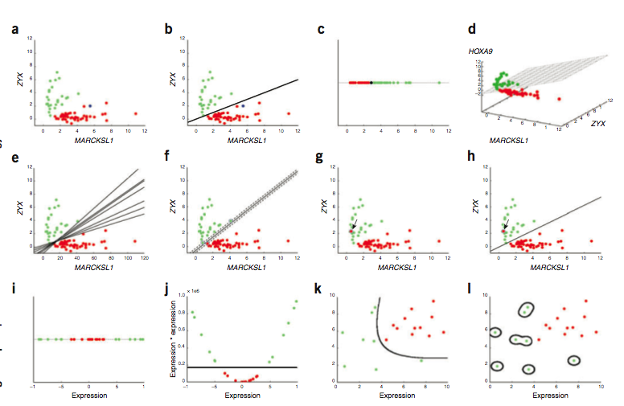
Support Vector Machine (SVM)
Noble, Nat Biotech 2006
Notes:
Now lets consider support vector machines, SVM. Here we again have gene expression data, for 2 genes along the top row. SVM wants to find the line that best separates the red from the green. In 1c we have the even simpler case of one gene expression value only. Here a point can separate the classes. In figure d we move up to 3 dimensions so we use a plane to seperate them. In general SVM will find the hyperplane that separates the samples, this just means the plane in > 3 dimensions.
Note figure e at the start of the second row. There are multiple lines we can use to separate the classes. So what SVM does is shown in F, which is find the line with the largest margin between the samples and the line. In g,h we see that we can also allow for some mistakes which are referred to as soft margins in that some samples can be allowed within or across the margins of the selected planes.
Finally lets get back to a single dimension again in the bottom row. For some data (e.g. figure i) you cannot draw a line or select a point that separates the red from green. SVM will try to transform the data (e.g. figure J ) to construct a separating line and then project that line back into the untransformed space (figure k). So in J we use a square function to transform the data to make it easier to generate a separating line. If you take this too far you get figure L : overfitting which looks like this.

Slide 10
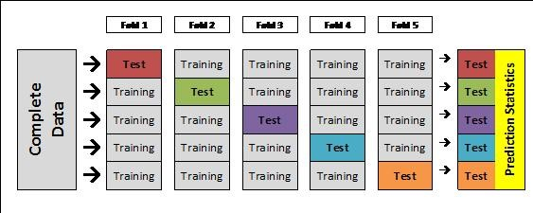
Testing the Classifier
# of cases correctly classified
total # of cases
error rate =
Evaluation on independent test set
Build the classifier on the train set.
Assess prediction performance on test set.
What if we don’t have an independent test set?
Cross Validation (XV):
Split the dataset into n folds (e.g., 10 folds of 10 samples each).
For each fold (e.g., for each group of 10 samples),
train (i.e., build model) on n-1 folds (e.g., on 90 samples),
test (i.e., predict) on left-out fold (e.g., on remaining 10 samples).
Combine test results.
Notes:
Finally, with any classifier we need a way to test whether it’s making the correct decisions. The most common way to do this is through cross-validation.
In cross-validation, you take a known data point and drop it from the training data. You then build your classifier and use it to predict the class of the known data point you dropped.
Since you know the class of this single point, you know whether the classifier has gotten the prediction right or not.
And then you repeat this process for each point in your training set, and by the end you should have built up a pretty good idea of how often you’re getting your predictions right.

Slide 11
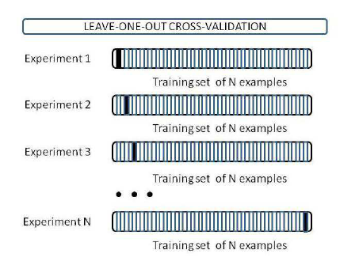
Testing the Classifier
Usually we us leave one out cross-validation
Notes:
Bias-Variance decomposition:
Squared “bias”: mesaures how closely the learning algorithm’s average guess (over all possible training sets of the given size) matches the target.
“Variance”: measures how much the learning algorithm’s guess “bounces around” for the different training sets of the given size.

Slide 12
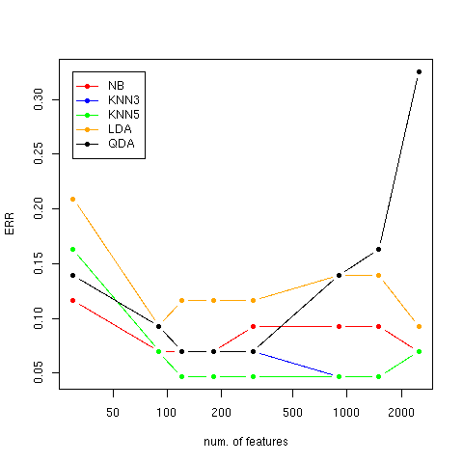
Testing the Classifier
Learning curves – leave one out cross validation
ALL vs. MLL vs. AML
More features are not always better…
Notes:
On ALL/MLL/ALL dataset
Key point – as # features increase accuracy does not but you may be adding noise to the picture
Everyhing will climb as you move out
Low features - miss some intersting stuff
Too many features and you overfit
- since LOO you get better and better training performance but the one prediction gets worse, add genes that are correlated but add nothing to the prediction except noise
Some classifiers are more sensitive to overfitting (eg GDA). KNN is not too bad

Slide 13
Classification
GenePattern methods
Split data into train and test set – SplitDatasetTrainTest
Explore different feature selection methods and different classifiers on train set by cross validation.
CARTXValidation
KNNXValidation
WeightedVotingXValidation
SVM
Once the “best” classifier and best classifier parameters have been selected (based on cross validation)
CART
KNN
WeightedVoting
SVM
Examine results:
PredictionReultsViewer
FeatureSummaryViewer

Slide 14
References
Golub, T.R., et al., Molecular Classification of Cancer: Class Discovery and Class Prediction by Gene Expression. Science, October 15 1999. 286(5439): p. 531-537.
Quackenbush, J., Computational Analysis of Microarray Data. Nature Reviews Genetics, June 2001. 2: p. 418-427.
Tibshirani, R., et al., Diagnosis of multiple cancer types by shrunken centroids of gene expression. PNAS, 2002. 99(10): p. 6567-6572.
Slonim, D.K., et al., Class Prediction and Discovery Using Gene Expression Data, in RECOMB 2000: The Fourth Annual International Conference on Research in Computational Molecular Biology. 2000: Tokyo, Japan. p. 263-272.
Ramoni, M.F., P. Sebastiani, and I.S. Kohane, From the Cover: Cluster analysis of gene expression dynamics. PNAS, 2002. 99(14): p. 9121-9126.
Savage, K.J., et al., The molecular signature of mediastinal large B-cell lymphoma differs from that of other diffuse large B-cell lymphomas and shares features with classical Hodgkin's lymphoma. Blood, 2003. 102(12): p. 3871-3879
…

Slide 15
Classification and
Prediction Exercise
BioITWorld Classification and Prediction
Notes:
So that’s the theory. Let’s start doing classification. You ought to be able to find the notebook for this section by searching for the text shown on the screen.

